Slide 1
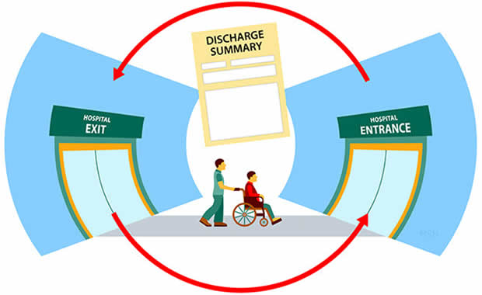
“Re-admission possibility of a patient into the hospital”

Slide 2
Slide 1
Problem Statement and Business Overview
Data Insights
Metric Evaluation & Patterns
Data Pre Processing and Feature Engineering
Model Building
AGENDA
Summary

Slide 3
Objective
In order to avoid the readmission of the treated patient with in that time period we will be going to make a model to predict the readmission of the patients. So, that a proper action can be taken in order to take a precautionary action to reduce the patients from readmitting.

Slide 4


Business Problem
Every business needs to be in top in every domain but the problem with health care industry mainly with hospitals is that patients readmission with in 30days due to which the hospitals image is at stake.
Treatment
Discharge
H
Major issue is readmission due to which hospital image gets down.
Hospitalisation
No-Readmission
Readmission

Slide 5
INTRODUCTION
The data we used was an extract representing 10 years (1999–2008) of clinical care at 130 hospitals and integrated delivery networks throughout the United States:
Midwest (18), Northeast (58), South (28), and West (16).
The database consists of 41 tables. The database includes 74,036,643 unique encounters (visits) that correspond to 17,880,231 unique patients and 2,889,571 providers. Because this data represents integrated delivery network health systems, it contains both inpatient and outpatient data, including emergency department, for the same group of patients. However, data from out-of-network providers is not captured.
Information was extracted from the database for encounters that satisfied the following criteria.
(1) It is an inpatient encounter (a hospital admission).
(2) It is a “diabetic” encounter, that is, one during which any kind of diabetes was entered to the system as a diagnosis.
(3) The length of stay was at least 1 day and at most 14 days.
(4) Laboratory tests were performed during the encounter.
(5) Medications were administered during the encounter.
This Dataset has 101766 rows and 50 columns.
Rows : 101766 Features: 50

Slide 6
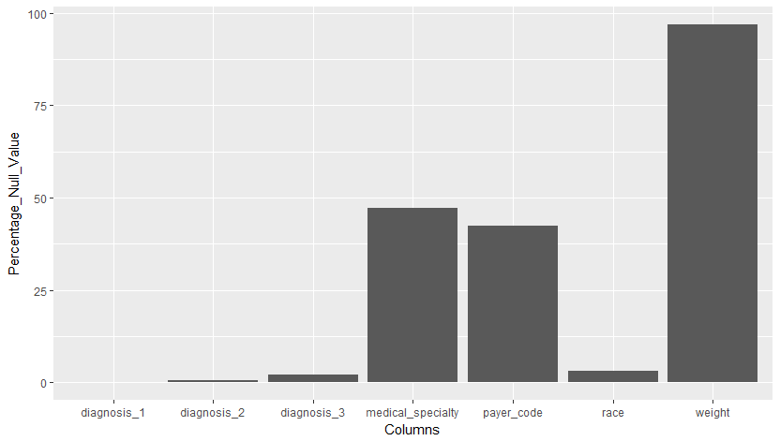
Null values Distribution in the dataset

Slide 7
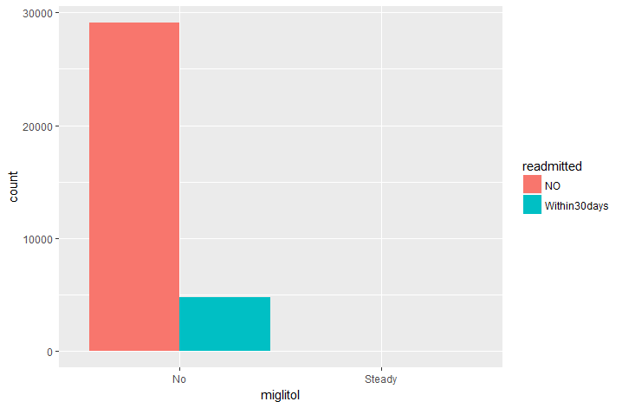
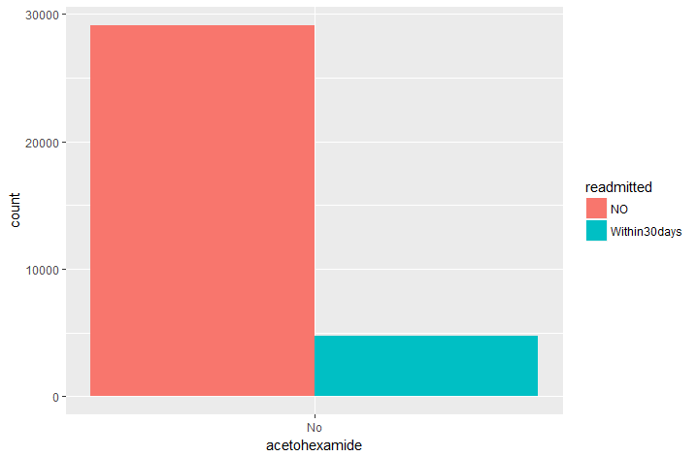

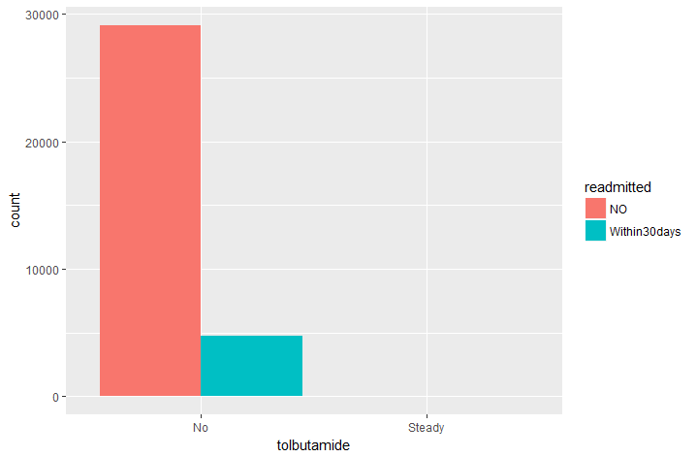
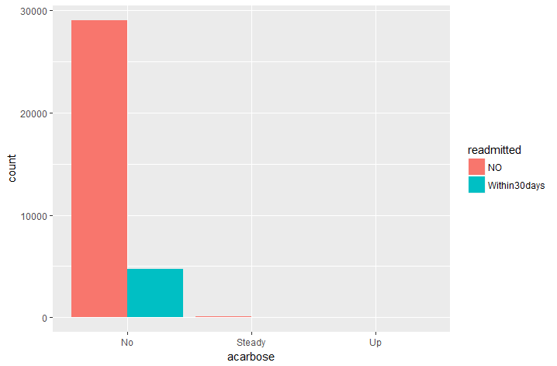
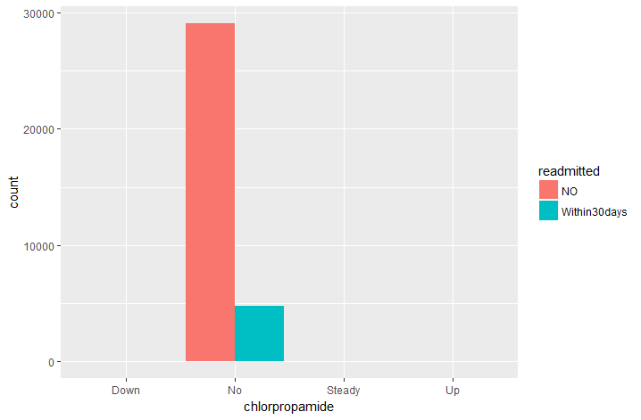
Drugs vs Re-admitted distribution

Slide 8
DATA Pre-Processing and Feature Engineering
Data Pre-Processing
Feature Engineering
Variable Extraction
One columns have more than 90% na values and where dropped.
Weight, pair-code, citogliptin, examide
Also, below records were dropped:
The discharge disposition of 11,19,20,21, patients who died
Each variable comprising missing values were independently analyzed, as the methods to be applied differs based on statistics but also best practices and industry knowledge. In this particular case, the missing values are encoded as “?”, which is not a standard missing value format.
Hence, the missing values were encoded as a new category labeled “Missing”
A new Features are been extracted based on the existing variables.
New Features are:
service_utilization,
admission_type_id re-coding,
ICD 9 diagnosis Coding
Medical speciality re-grouped
The chi-square analysis to taken only the important variables into consideration.
Variables Extraction

Slide 9
Feature engineering
Service utilization
Re - leveling Attributes
number_outpatient + number_emergency + number_inpatient
admission_type_id
8 levels to 2 levels
admission_source_id
26 levels to 12 levels
Age
Mean
ICD 9 Levels clubbing:
A1Cresult and Ma Gluc serum
Clubbed into 3 levels
Diag 1, Diag 2, Diag 3 were more than 600 levels are combined to make 9 levels

Slide 10
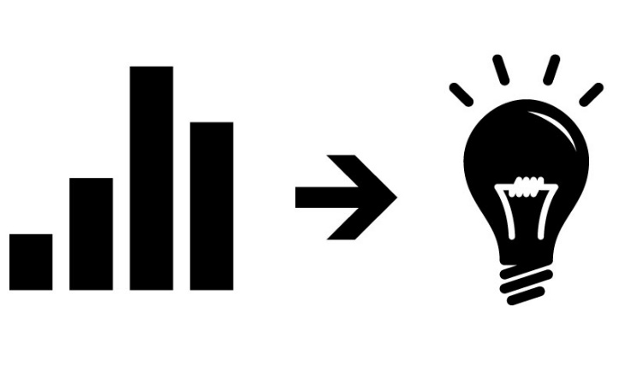
Data Insights

Slide 11
Checking the class imbalance and NO of different type of attributes
Data balancing techniques were included to get the data balanced.
Various techniques are: Over, Under, Smote and Rose Smote.

Slide 12
Readmission Pattern with features
As age increases there is steep increase in the percentage of readmission and which will be driving factor to predict the readmission.
From the diagnosis graph it is shown that there is steep increase in the percentage of readmission as the number of diagnosis increases.

Slide 13
Readmission Pattern with features
As the number of days stayed increases there is a increase in readmission as this might lead to major health concerned patients.
Even the drug which is most of the time prescribed was insulin and even other drugs year on year got decreased.

Slide 14
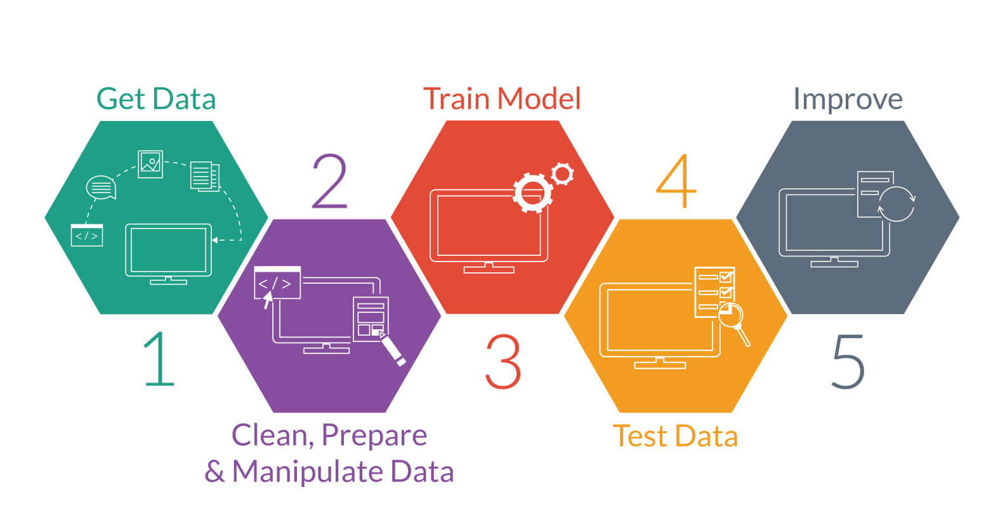
Model Building

Slide 15
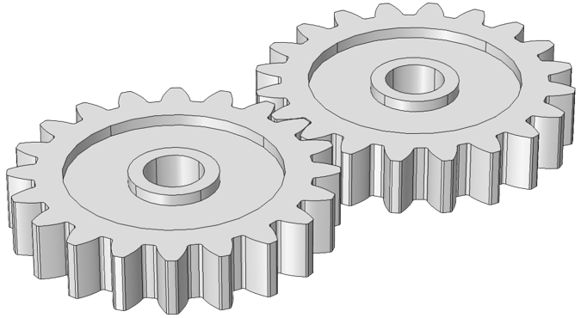
Model Building
MODEL
Patients Data Base
Within30days
Input
Output
NO
Input
Predictions
Within30days
New Data
NO
Target Labels

Slide 16
Case 1: Using all the variables and data sampling techniques
From the above charts it is clear that Voting Classifier is performing well on the dataset with all the variables.

Slide 17
Case 2: Using only feature variables and chi-square test
From the above graph it is clear the Voting Classifier is giving better result the sensitivity in that data is very low due to which this model will not be suitable to make as a base to predict the model.

Slide 18
Tools and Hyper parameters used in the model
Logistic Regression: Used the model with Cross validation and no such hyper parameter used to tune it. Even the threshold was selected using the auc.
Decision Tree: Used the model with Cross validation and hyper parameters which were tuned are max_depth in order to avoid the overfitting of the model by proper pruning.
Random Forest: Used the model with Cross validation and hyper parameters which were tuned are max_depth, n_estimators, max_features in order to avoid the overfitting of the model by proper pruning.
Ada Boost : Used the Baseline model in python and used the Cross Validation with Hyper parameter which where tuned are no of n_estimators
For visualisations Tableau and Excel are been used.

Slide 19
FINAL MODEL COMAPRISON FROM TWO APPROACHES
Final Model:
Voting Classifier and Random Forest Classifier

Slide 20
SUMMARY
As there is strong urge for the interpretability then we will be going for Random Forest as it gives more interpretability when compared to other models.
If Metric is important rather than interpretability then we will be going for the Neural net ensemble as it capture the non linear patterns and even the feature variables.
The Variables which are driving the decision the most are:
Number of days stayed
Number of Procedures
Number of medications
Number of Diagnosis
Age
Discharge Disposition ID

Slide 21
References
Ian H. Witten, Eibe Frank, Mark A. Hall, Data Mining: Practical Machine Learning Tools and Techniques, 3rd edition, Elsevier, 2011
http://topepo.github.io/caret/train-models-by-tag.html
https://www.analyticsvidhya.com/blog/2016/04/complete-tutorial-tree-based-modeling-scratch-in-python/
https://www.analyticsvidhya.com/blog/2017/09/naive-bayes-explained/
https://www.analyticsvidhya.com/blog/2015/11/beginners-guide-on-logistic-regression-in-r/
http://journals.plos.org/plosone/article?id=10.1371/journal.pone.0182900
Tamraparni Dasu and Theodore Johnson, Exploratory Data Mining and Data Quality, Wiley, 2004.
Wikipedia - https://en.wikipedia.org/wiki/AdaBoost
https://en.wikipedia.org/wiki/Receiver_operating_characteristic
http://www.rdatamining.com/examples/association-rules

Slide 22
Q&A

Slide 23
THANK YOU!!!

